Slide 1

UI/UX Design Analysis of Blinkit Mobile Application
ALAN MATHEW JEROM E
BSC AI & ML

Slide 2
Introduction
Blinkit is a quick commerce mobile application used to order groceries, snacks, medicines, and other daily essentials. The app is designed to help users find products easily and place orders quickly.

Slide 3
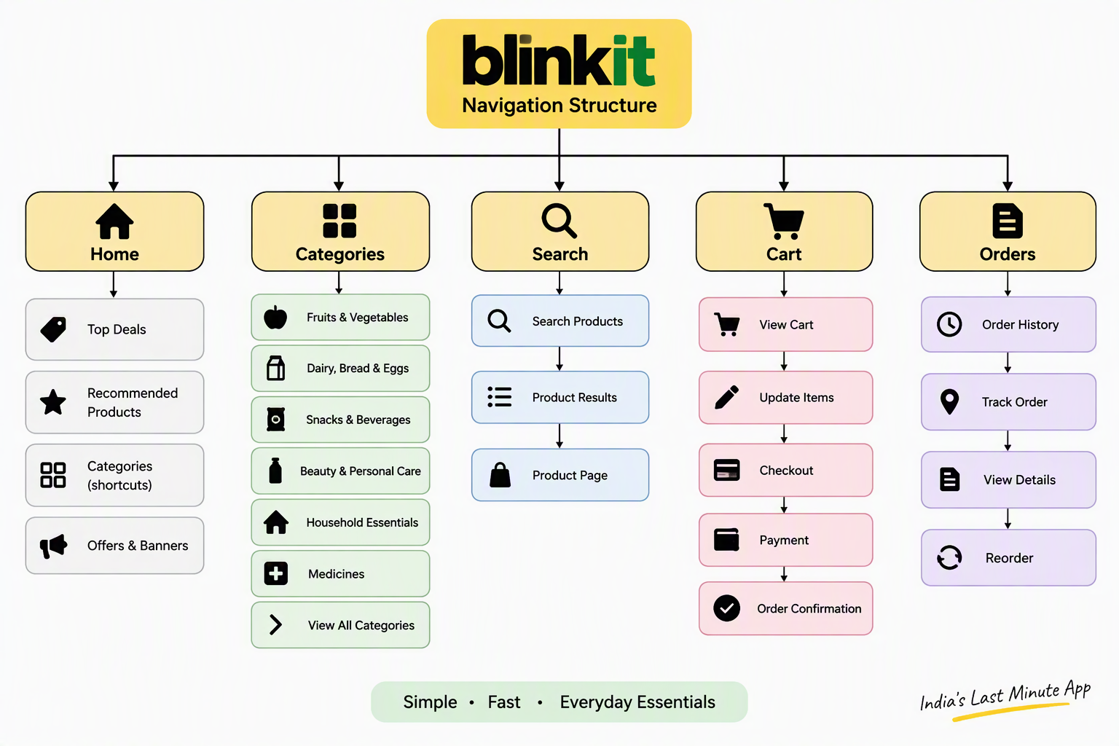
1. Navigation Structure
Blinkit has a simple navigation system with categories, search options, and a cart.
Analysis:
Products are divided into categories.
Search bar is available on the home screen.
Users can easily access their cart and orders.
Navigation is simple and easy to understand.

Slide 4
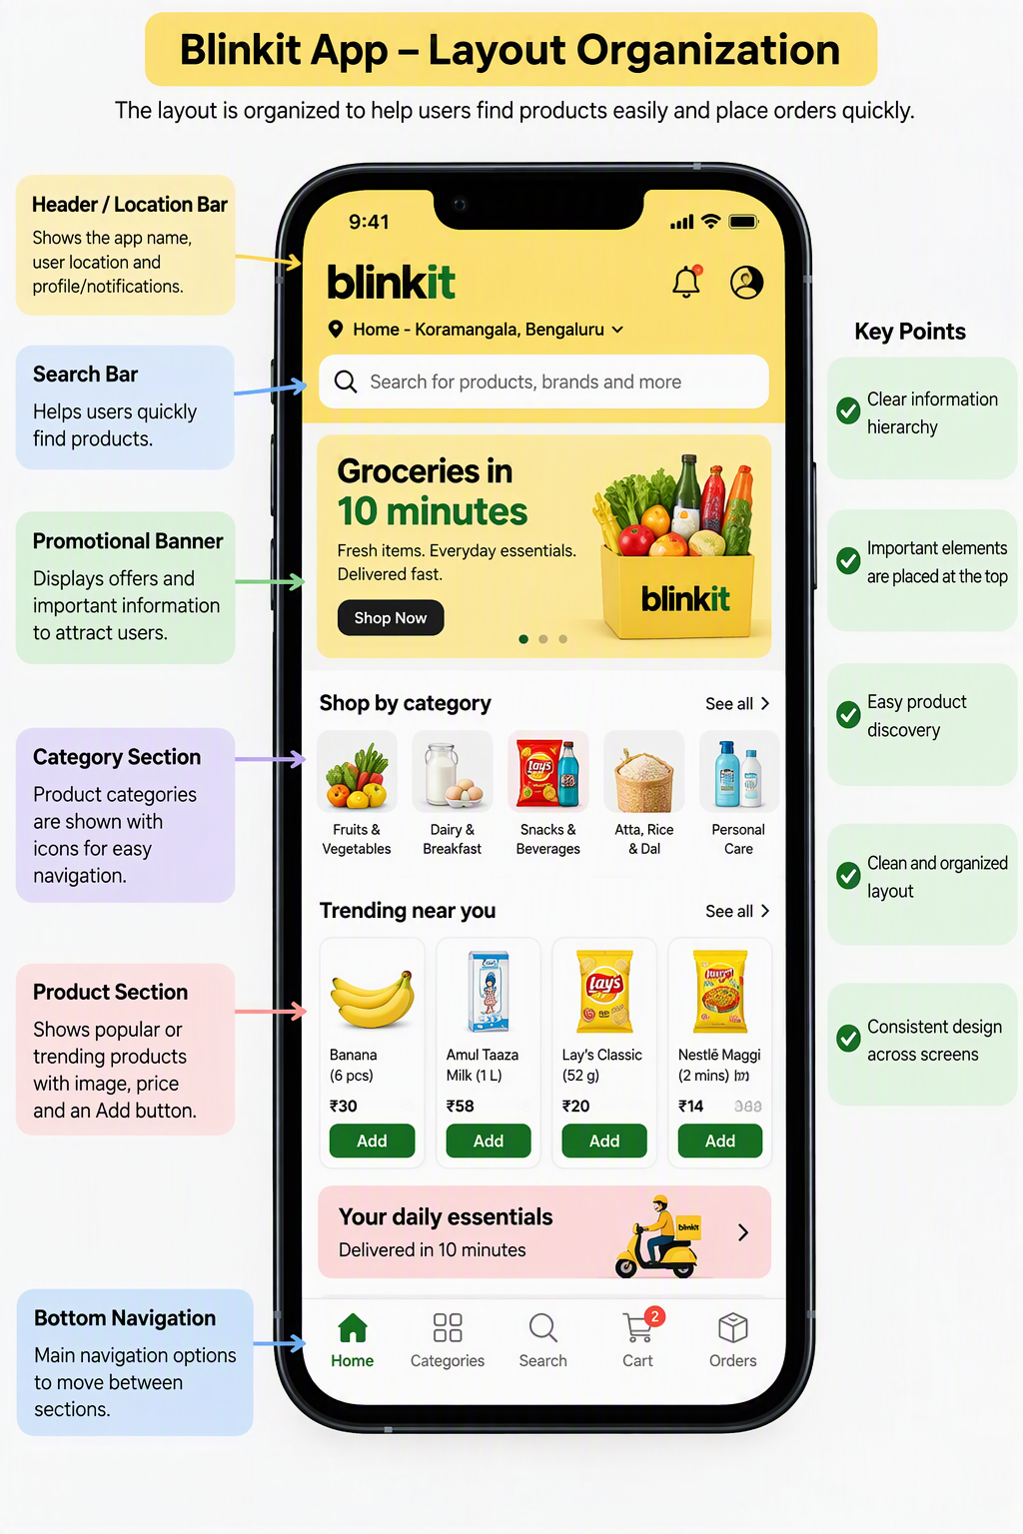
2. Layout Organization
The layout is clean and organized.
Analysis:
Products are displayed with images and prices.
Categories are arranged clearly.
Important information is visible on the screen.
Users can quickly find the products they need.

Slide 5
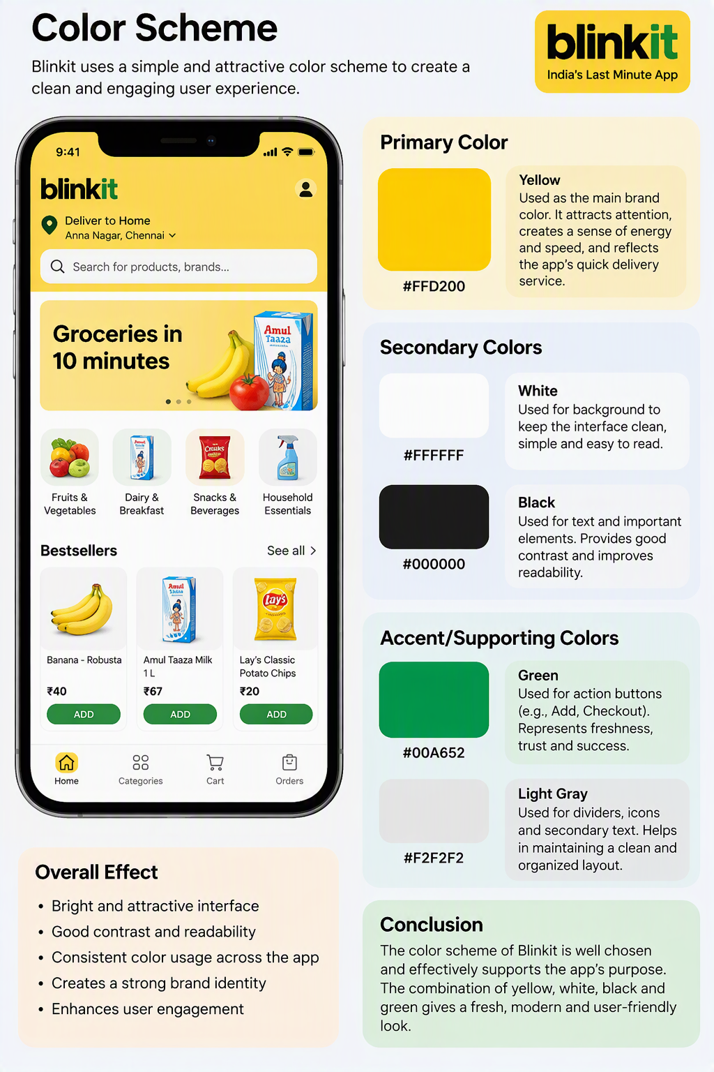
3. Color Scheme
Blinkit mainly uses yellow, black, and white colors.
Analysis:
Yellow attracts user attention.
White background improves readability.
Consistent colors help create brand identity.

Slide 6
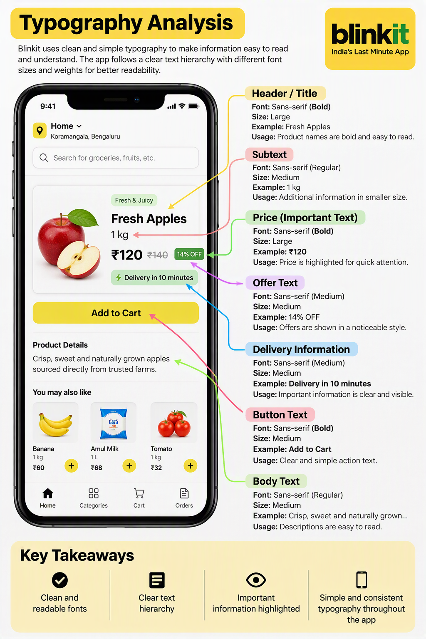
4. Typography
Blinkit uses simple and readable fonts.
Analysis:
Product names are clear.
Prices are highlighted properly.
Font size is suitable for mobile users.

Slide 7
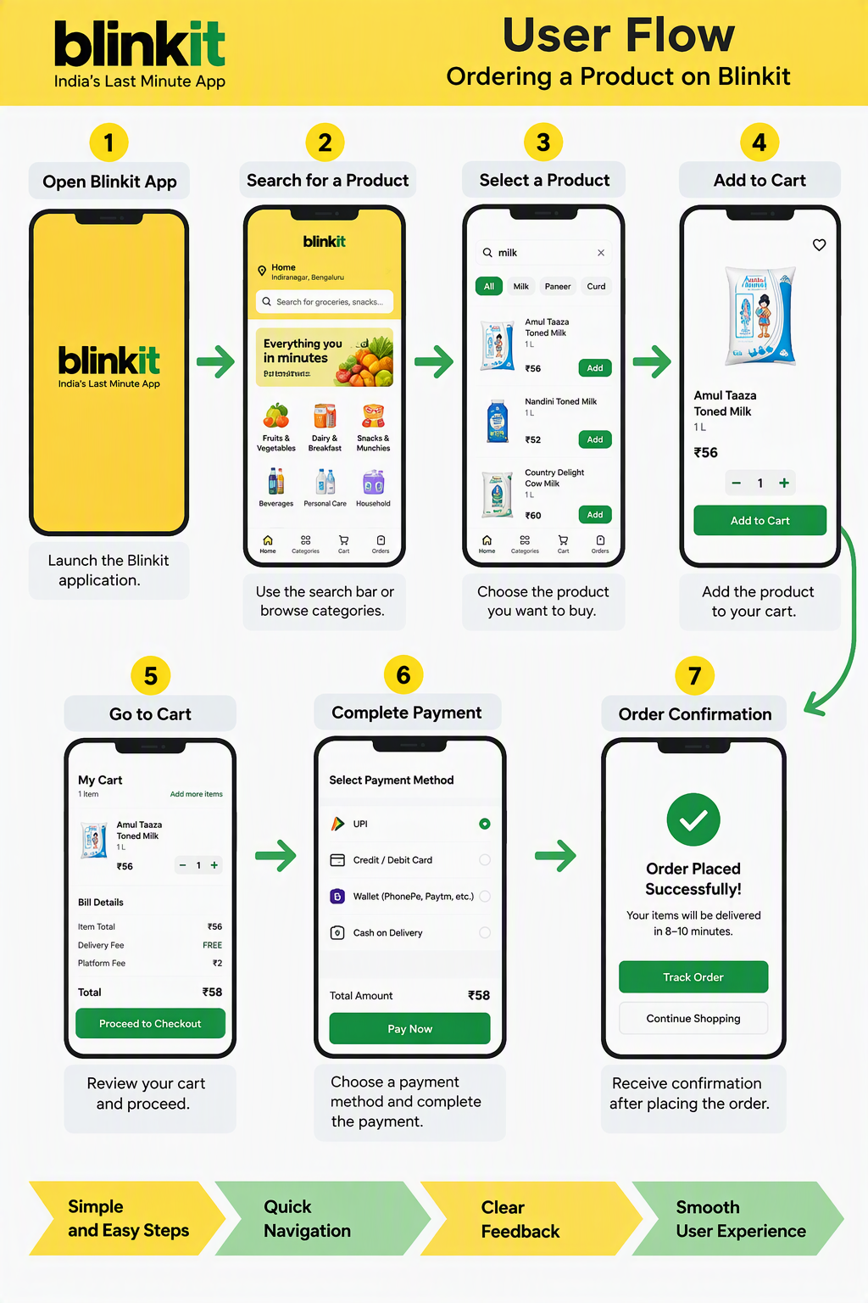
5. User Flow
Steps to Order a Product
Open Blinkit.
Search for a product.
Select the product.
Add it to the cart.
Complete the payment.
Analysis:
Ordering process is quick.
Few steps are required.
Users receive confirmation after placing an order.

Slide 8
Strengths
Easy navigation.
Attractive layout.
Fast ordering process.
Clear product images.
Good search functionality.

Slide 9
Weaknesses
Too many product suggestions may distract users.
Some items may be unavailable in certain locations.
The home screen can sometimes look crowded.

Slide 10
Conclusion
Blinkit has a user-friendly interface and provides a smooth shopping experience. Its simple navigation, organized layout, attractive colors, and easy ordering process make it convenient for users. Overall, Blinkit is a good example of effective mobile app UI and UX design.

Slide 11
Learning Outcome
This experiment helped me understand how navigation, layout, color scheme, typography, and user flow are used in a real mobile application. It also helped me learn how to identify the strengths and weaknesses of a user interface.

